Slide 1
Generative Adversarial Networks (GANs)

Slide 2
Outline
Part 1: Introduction to GANs
Part 2: Code of GANs
Part 3: Applications of GANs

Slide 3
Part 1
Motivation for Generative Models
From Adversarial Training to GANs
GAN’s Architecture
GAN’s objective
DCGANs

Slide 4
GANs
Generative
Learn a generative model
Adversarial
Trained in an adversarial setting
Networks
Use Deep Neural Networks

Slide 5
Why Generative Models?
We’ve only seen discriminative models so far
Given an image X, predict a label Y
Estimates P(Y|X)
Discriminative models have several key limitations
Can’t model P(X), i.e. the probability of seeing a certain image
Thus, can’t sample from P(X), i.e. can’t generate new images
Generative models (in general) cope with all of above
Can model P(X)
Can generate new images

Slide 6
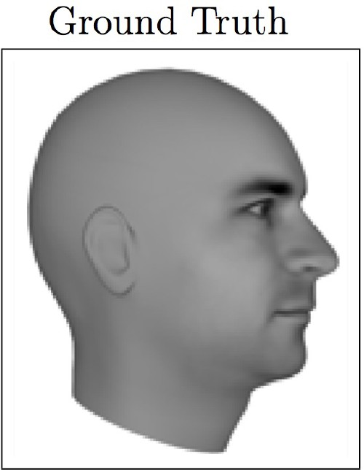
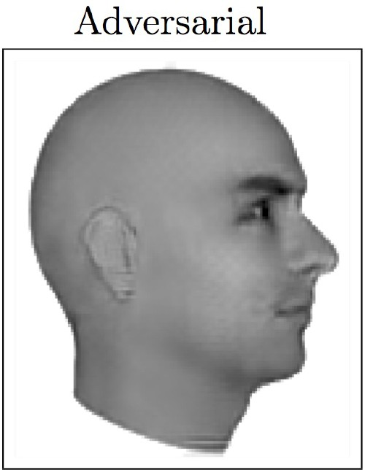
Magic of GANs…
Lotter, William, Gabriel Kreiman, and David Cox. "Unsupervised learning of visual structure using predictive generative networks." arXiv preprint arXiv:1511.06380 (2015).

Slide 7
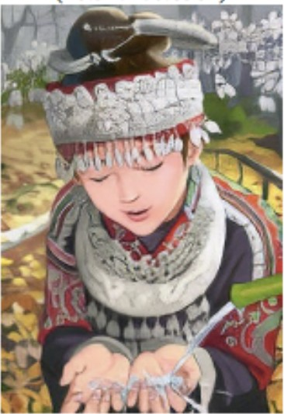
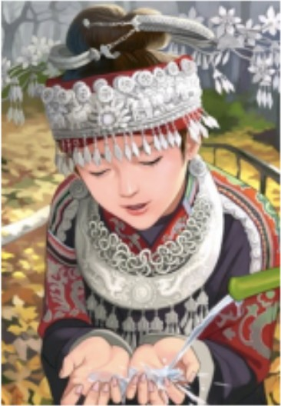
Magic of GANs…
Which one is Computer generated?
Ledig, Christian, et al. "Photo-realistic single image super-resolution using a generative adversarial network." arXiv preprint arXiv:1609.04802 (2016).

Slide 8
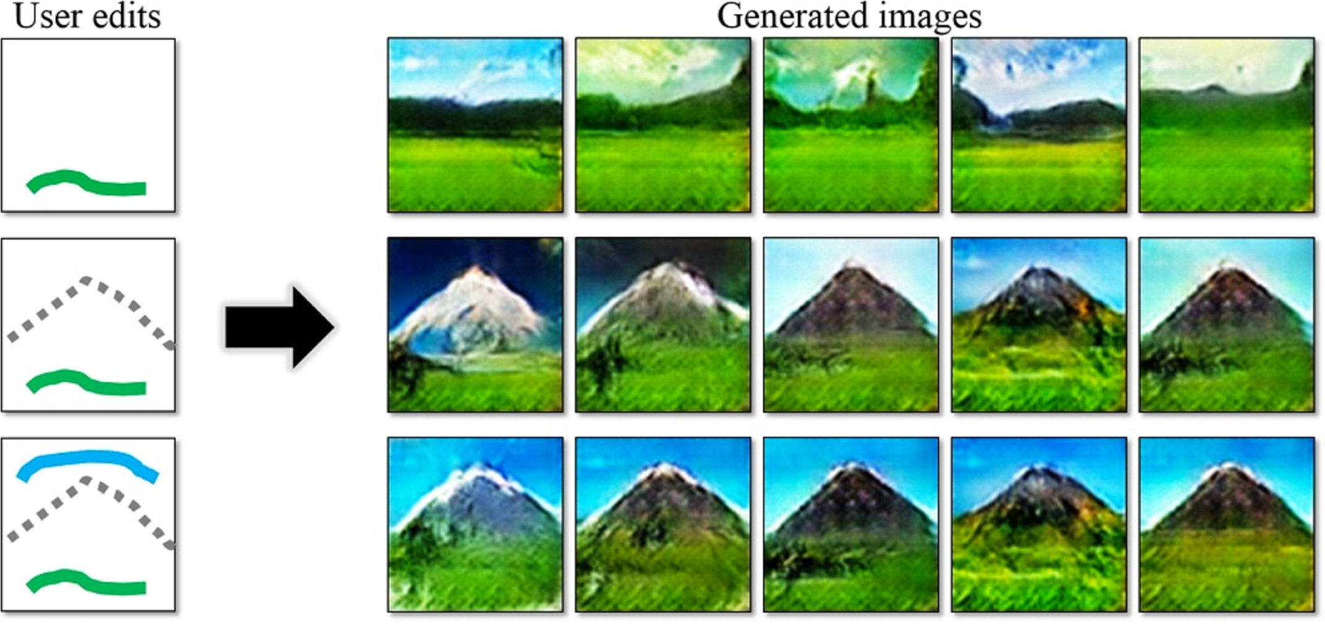
Magic of GANs…
http://people.eecs.berkeley.edu/~junyanz/projects/gvm/

Slide 9
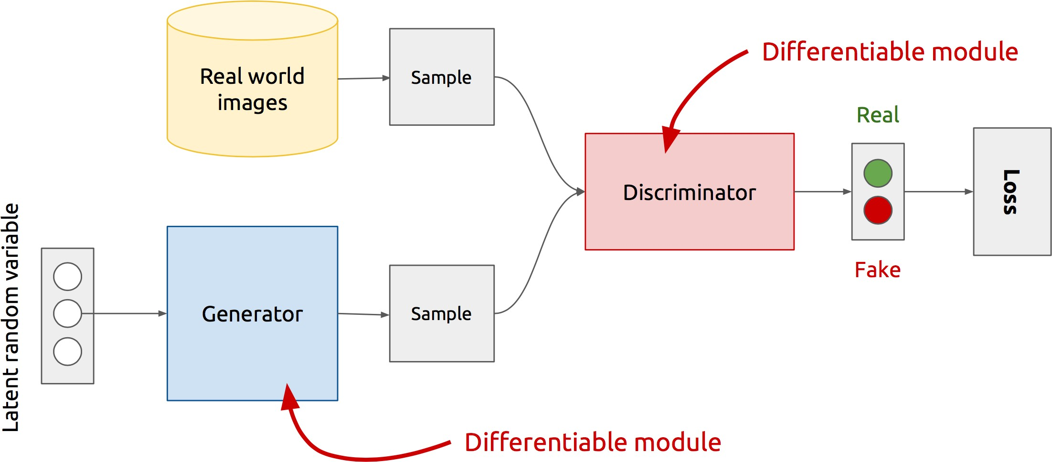
GAN’s Architecture
x
D
D(x)
G
z
G(z)
D(G(z))
Z is some random noise (Gaussian/Uniform).
Z can be thought as the latent representation of the image.
https://www.slideshare.net/xavigiro/deep-learning-for-computer-vision-generative-models-and-adversarial-training-upc-2016

Slide 10
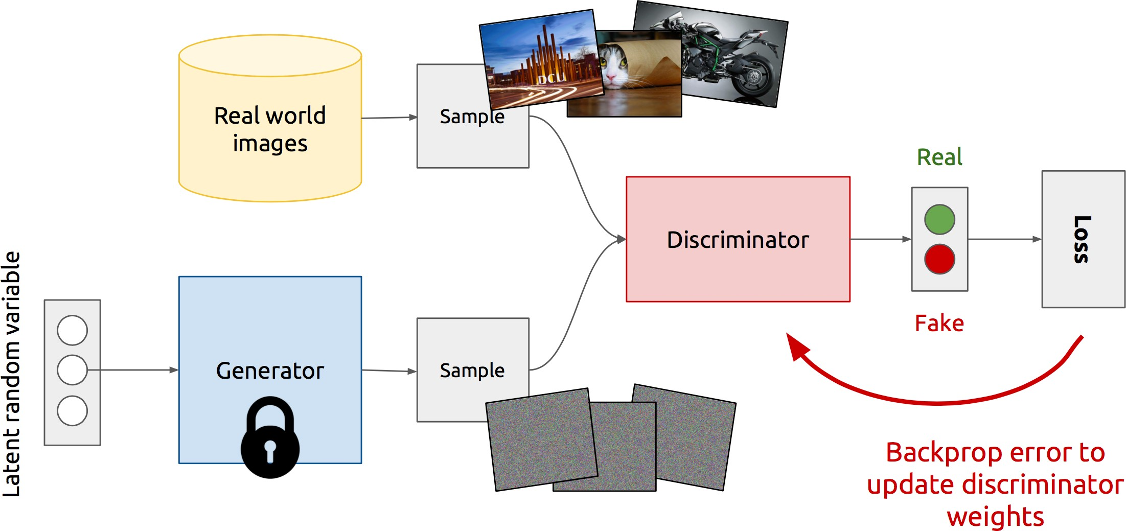
Training Discriminator
https://www.slideshare.net/xavigiro/deep-learning-for-computer-vision-generative-models-and-adversarial-training-upc-2016

Slide 11
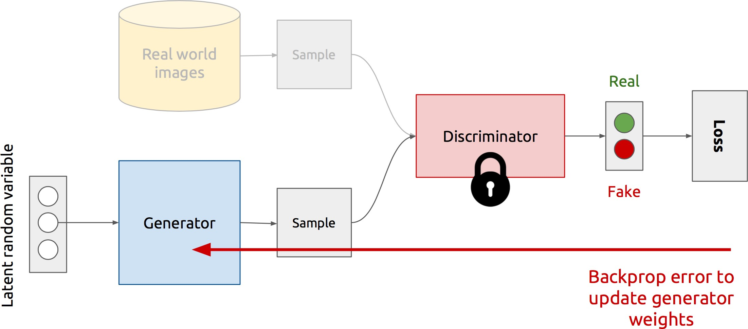
Training Generator
https://www.slideshare.net/xavigiro/deep-learning-for-computer-vision-generative-models-and-adversarial-training-upc-2016

Slide 12
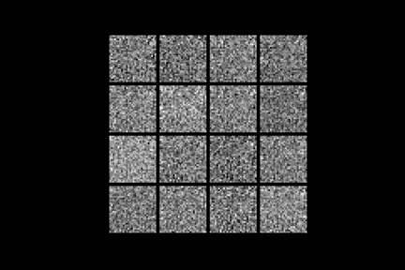
Generator in action
https://openai.com/blog/generative-models/

Slide 13
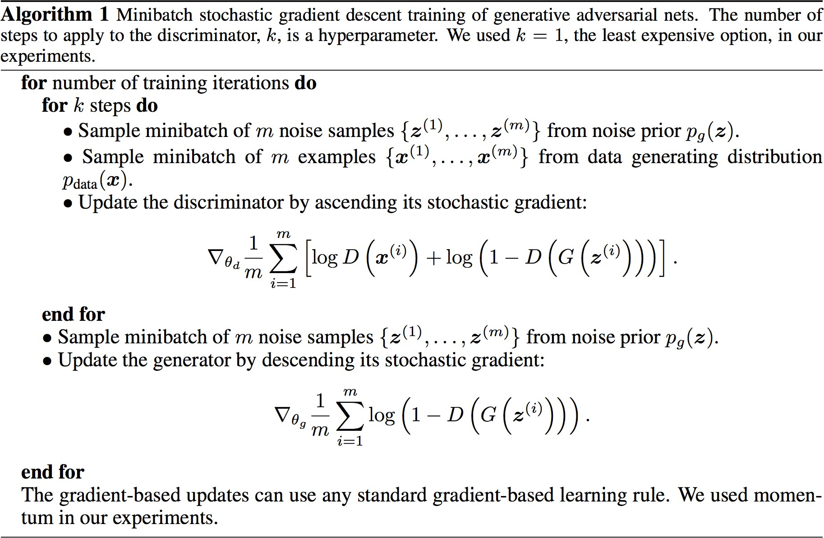
Discriminator updates
Generator updates

Slide 14
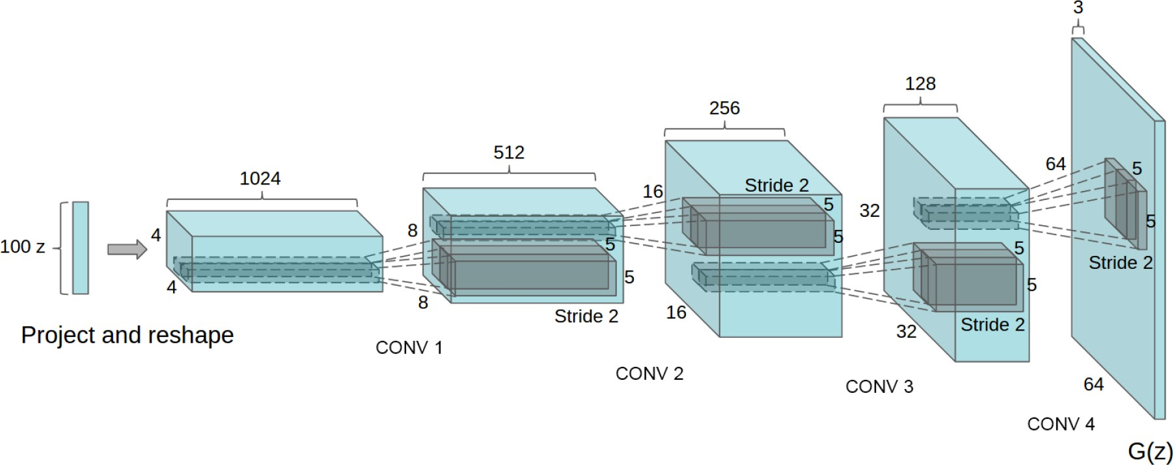
Deep Convolutional GANs (DCGANs)
Key ideas:
Replace FC hidden layers with Convolutions
Generator: Fractional-Strided convolutions
Use Batch Normalization after each layer
Inside Generator
Use ReLU for hidden layers
Use Tanh for the output layer
Generator Architecture
Radford, Alec, Luke Metz, and Soumith Chintala. "Unsupervised representation learning with deep convolutional generative adversarial networks." arXiv:1511.06434 (2015).

Slide 15
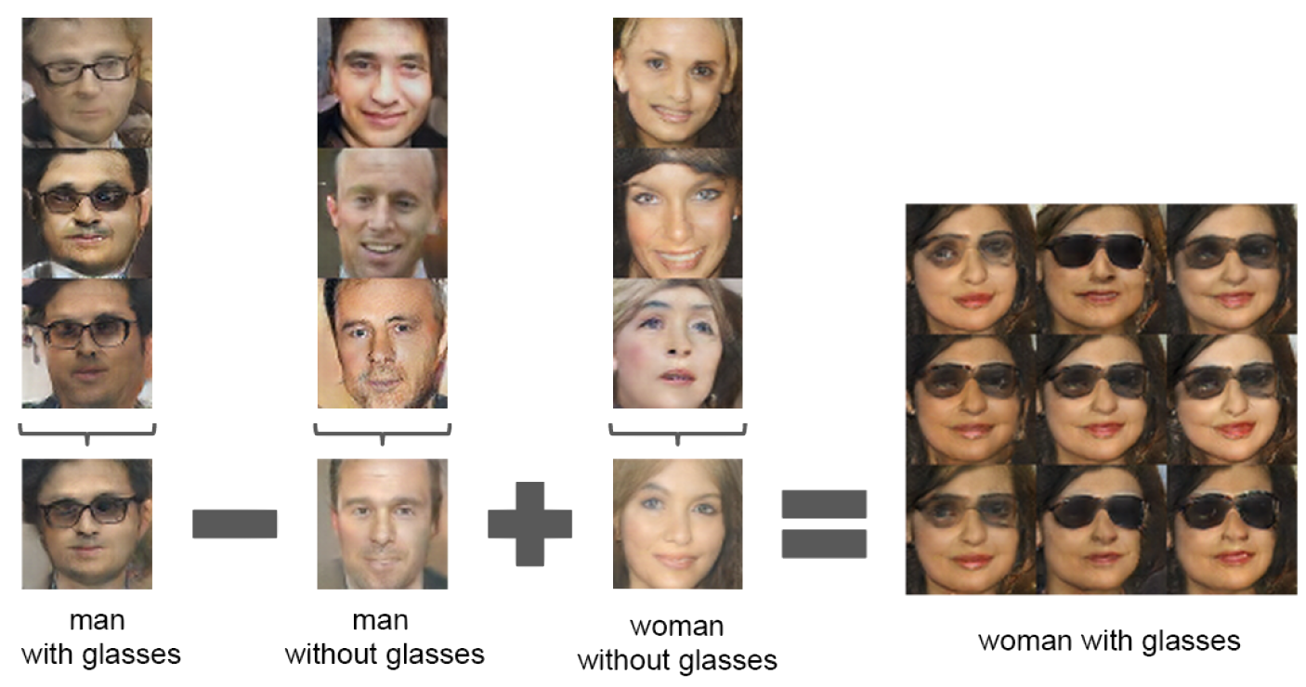
Latent vectors capture interesting patterns…
Radford, Alec, Luke Metz, and Soumith Chintala. "Unsupervised representation learning with deep convolutional generative adversarial networks." arXiv:1511.06434 (2015).

Slide 16
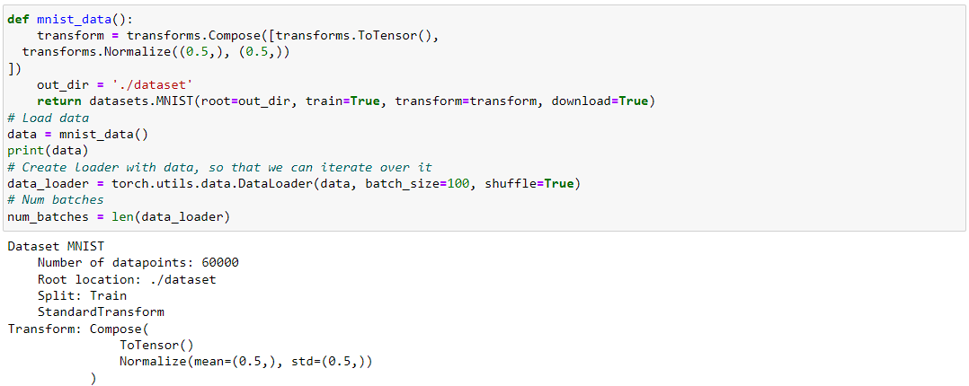
Part 2
Mist data set consist of hand writing numbers images to train out neural-network on it

Slide 17
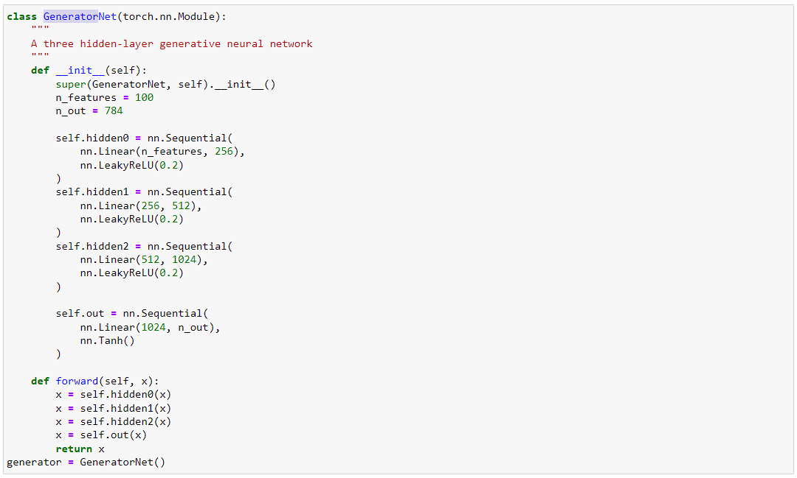
Generator
Generator net contest of three hidden layers
100 node at input layer
784 node at out put layer #28*28

Slide 18
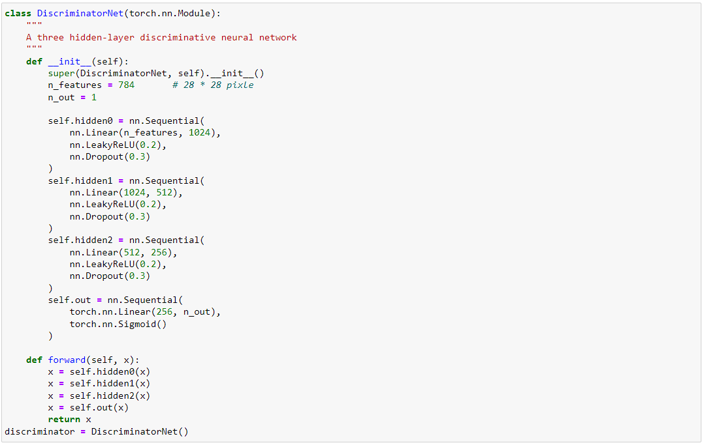
Discriminator
Discriminator net contest of three hidden layers
784 node at input layer #28*28
1 node at out put layer

Slide 19
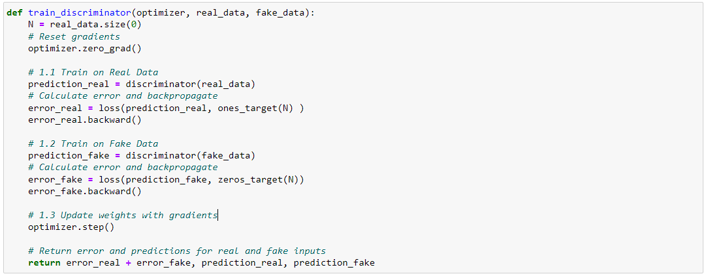
Train of Discriminator
Train the Discriminator on real and fake data
Return error
Return prediction of discriminator on real and fake data

Slide 20
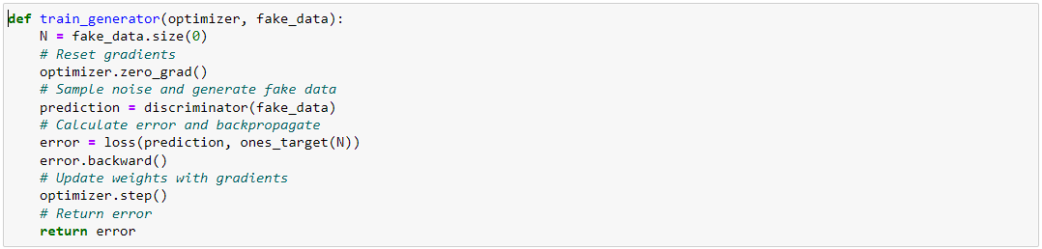
Train of Generator
Train the Generator on fake data (Prediction of Discriminator)
Return error

Slide 21
Part 3
Conditional GANs
Applications
Image-to-Image Translation
Text-to-Image Synthesis
Face Aging
Advanced GAN Extensions
Coupled GAN
Summary

Slide 22
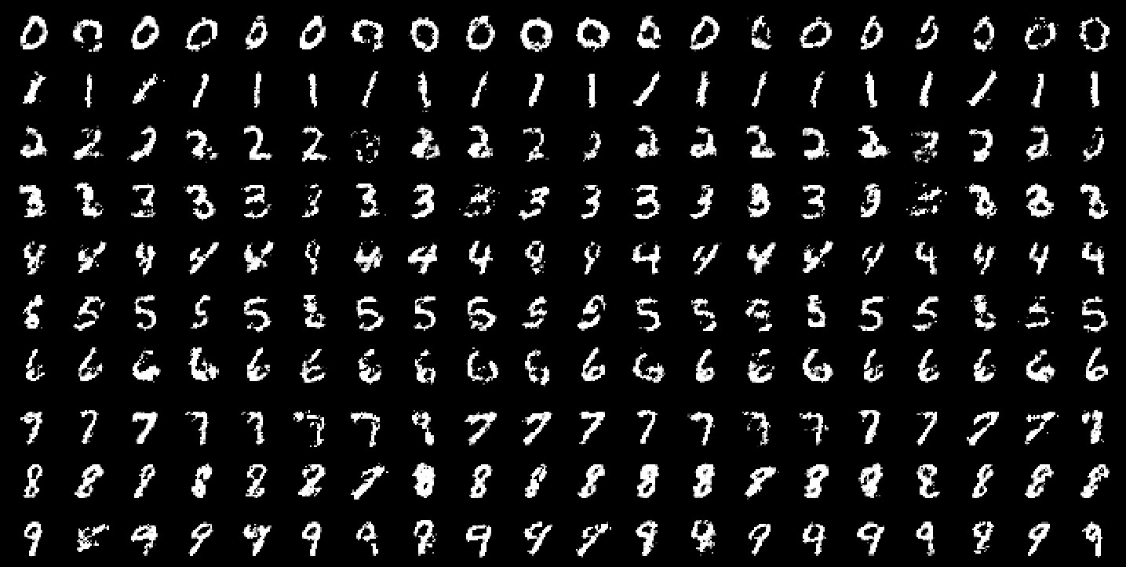
Conditional GANs
MNIST digits generated conditioned on their class label.
1, 0, 0, 0, 0, 0, 0, 0, 0, 0
0, 1, 0, 0, 0, 0, 0, 0, 0, 0
0, 0, 1, 0, 0, 0, 0, 0, 0, 0
0, 0, 0, 1, 0, 0, 0, 0, 0, 0
0, 0, 0, 0, 1, 0, 0, 0, 0, 0
0, 0, 0, 0, 0, 1, 0, 0, 0, 0
0, 0, 0, 0, 0, 0, 1, 0, 0, 0
0, 0, 0, 0, 0, 0, 0, 1, 0, 0
0, 0, 0, 0, 0, 0, 0, 0, 1, 0
0, 0, 0, 0, 0, 0, 0, 0, 0, 1
MN S g
Figure 2 in the original paper.
Mirza, Mehdi, and Simon Osindero. Conditional generative adversarial nets. arXiv preprint arXiv:1411.1784 (2014).

Slide 23
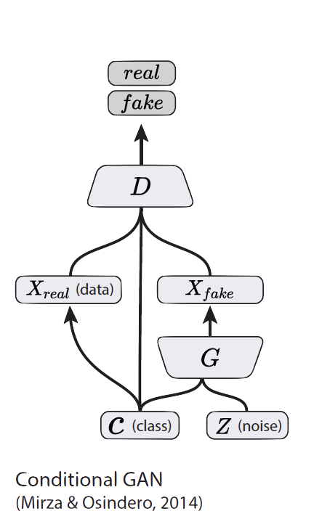
Conditional GANs
Simple modification to the original GAN framework that conditions the model on additional information for better multi-modal learning.
Lends to many practical applications of GANs when we have explicit supervision available.
Image Credit: Figure 2 in Odena, A., Olah, C. and Shlens, J., 2016. Conditional image synthesis with auxiliary classifier GANs. arXiv preprint arXiv:1610.09585.
Mirza, Mehdi, and Simon Osindero. “Conditional generative adversarial nets”. arXiv preprint arXiv:1411.1784 (2014).

Slide 24
Part 2
Conditional GANs
Applications
Image-to-Image Translation
Text-to-Image Synthesis
Face Aging
Advanced GAN Extensions
Coupled GAN
Summary

Slide 25
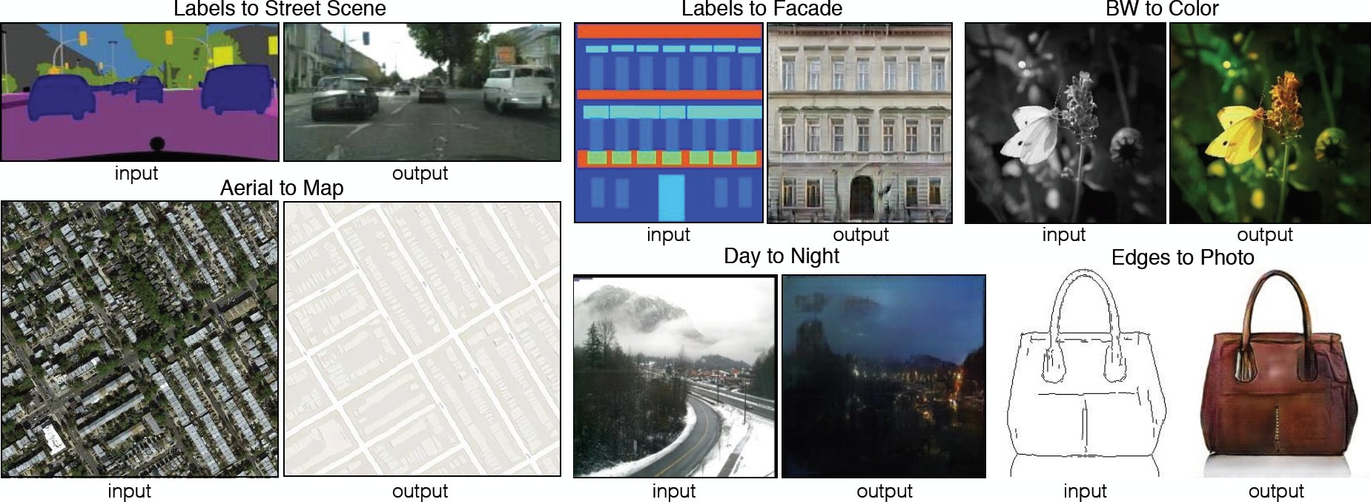
Image-to-Image Translation
Figure 1 in the original paper.
Link to an interactive demo of this paper
Isola, P., Zhu, J. Y., Zhou, T., & Efros, A. A. “Image-to-image translation with conditional adversarial networks”. arXiv preprint arXiv:1611.07004. (2016).

Slide 26
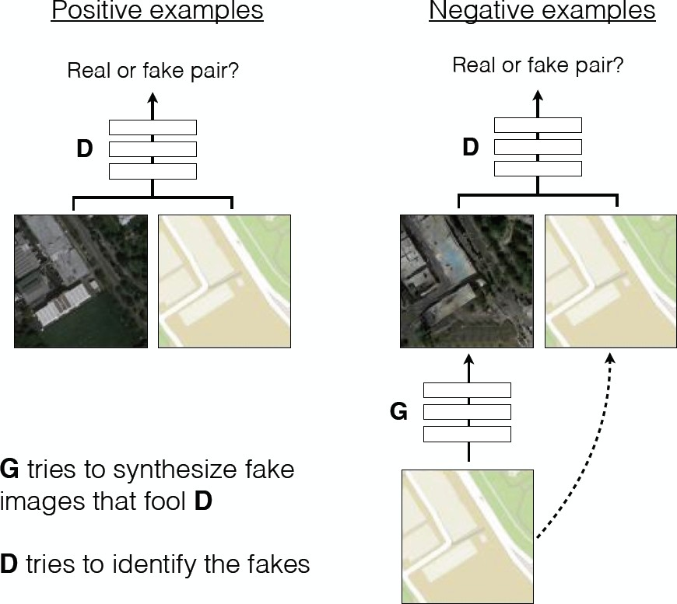
Image-to-Image Translation
Architecture: DCGAN-based architecture
Training is conditioned on the images from the source domain.
Conditional GANs provide an effective way to handle many complex domains without worrying about designing structured loss functions explicitly.
Figure 2 in the original paper.
Isola, P., Zhu, J. Y., Zhou, T., & Efros, A. A. “Image-to-image translation with conditional adversarial networks”. arXiv preprint arXiv:1611.07004. (2016).

Slide 27
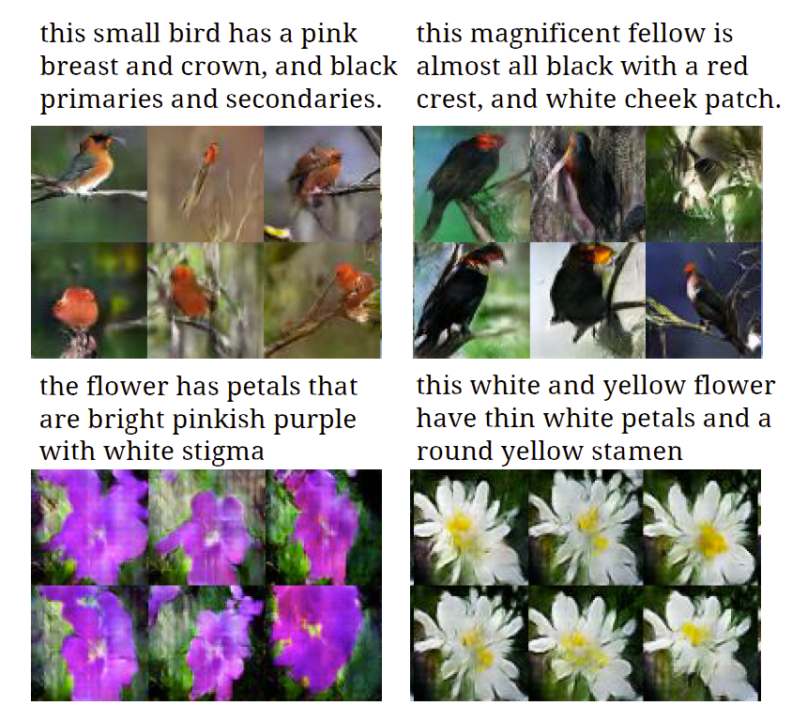
Text-to-Image Synthesis
Motivation
Given a text description, generate images closely associated.
Uses a conditional GAN with the generator and discriminator being condition on “dense” text embedding.
Figure 1 in the original paper.
Reed, S., Akata, Z., Yan, X., Logeswaran, L., Schiele, B., & Lee, H. “Generative adversarial text to image synthesis”. ICML (2016).

Slide 28
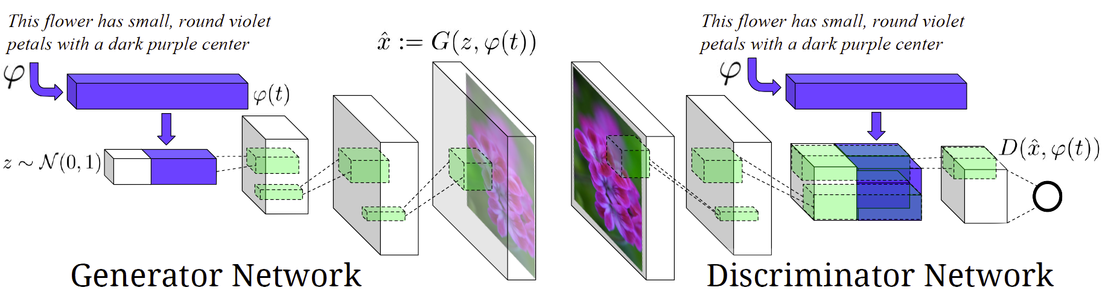
Text-to-Image Synthesis
Figure 2 in the original paper.
Positive Example: Real Image, Right Text
Negative Examples: Real Image, Wrong Text Fake Image, Right Text
Reed, S., Akata, Z., Yan, X., Logeswaran, L., Schiele, B., & Lee, H. “Generative adversarial text to image synthesis”. ICML (2016).

Slide 29
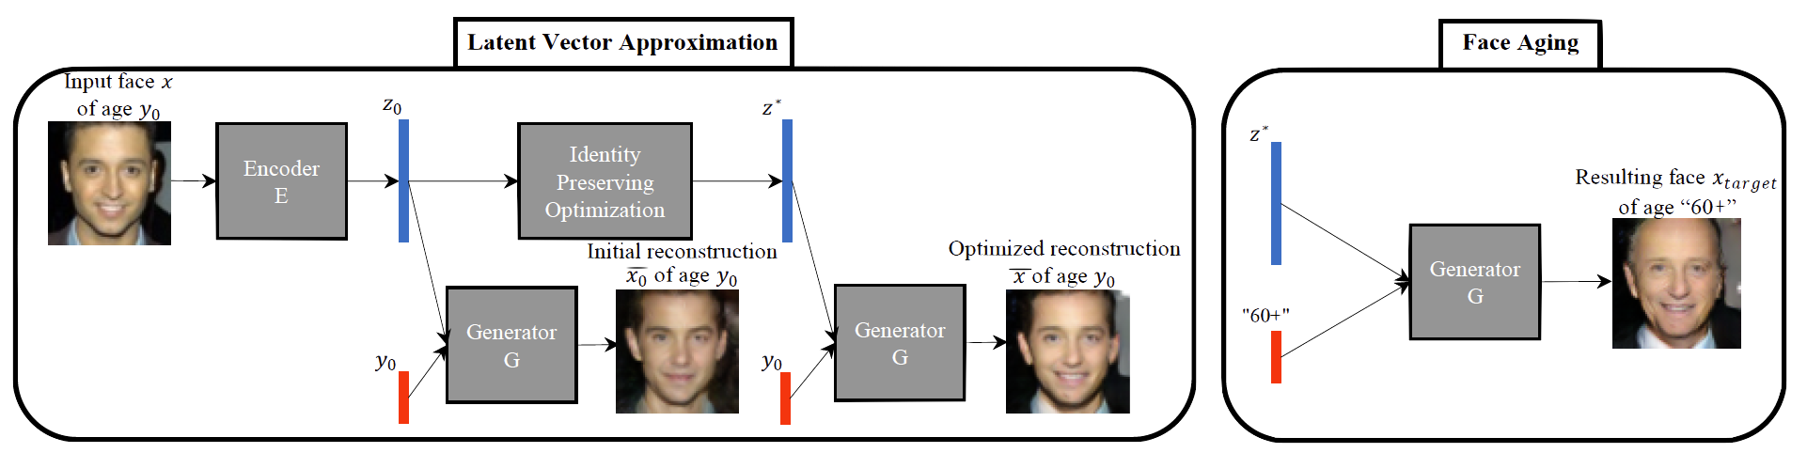
Face Aging with Conditional GANs
Differentiating Feature: Uses an Identity Preservation Optimization using an auxiliary network to get a better approximation of the latent code (z*) for an input image.
Latent code is then conditioned on a discrete (one-hot) embedding of age categories.
Figure 1 in the original paper.
Antipov, G., Baccouche, M., & Dugelay, J. L. (2017). “Face Aging With Conditional Generative Adversarial Networks”. arXiv preprint arXiv:1702.01983.

Slide 30
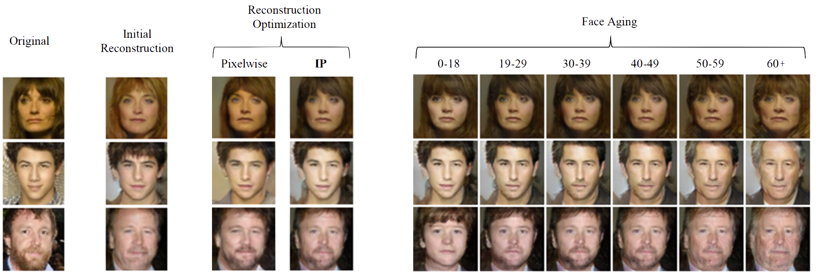
Face Aging with Conditional GANs
Figure 3 in the original paper.
Antipov, G., Baccouche, M., & Dugelay, J. L. (2017). “Face Aging With Conditional Generative Adversarial Networks”. arXiv preprint arXiv:1702.01983.

Slide 31
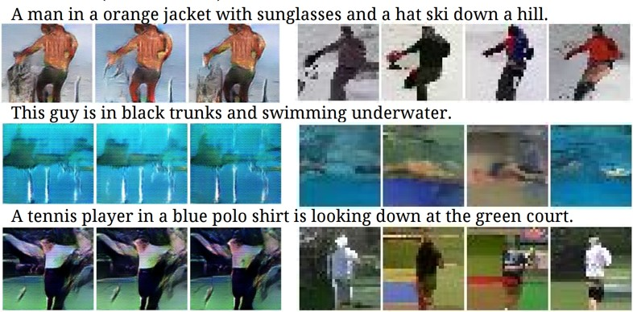
Conditional GANs
Conditional Model Collapse
Scenario observed when the Conditional GAN starts ignoring either the code (c) or the noise variables (z).
This limits the diversity of images generated.
Credit?
Mirza, Mehdi, and Simon Osindero. Conditional generative adversarial nets. arXiv preprint arXiv:1411.1784 (2014).

Slide 32
Part 3
Conditional GANs
Applications
Image-to-Image Translation
Text-to-Image Synthesis
Face Aging
Advanced GAN Extensions
Coupled GAN
Summary

Slide 33
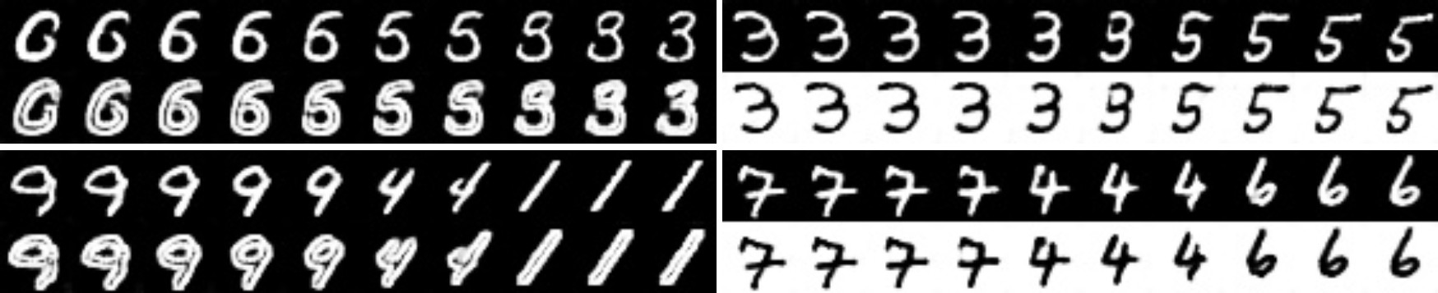
Coupled GAN
Figure 2 in the original paper.
Learning a joint distribution of multi-domain images.
Using GANs to learn the joint distribution with samples drawn from the marginal distributions.
Direct applications in domain adaptation and image translation.
Liu, Ming-Yu, and Oncel Tuzel. “Coupled generative adversarial networks”. NIPS (2016).

Slide 34
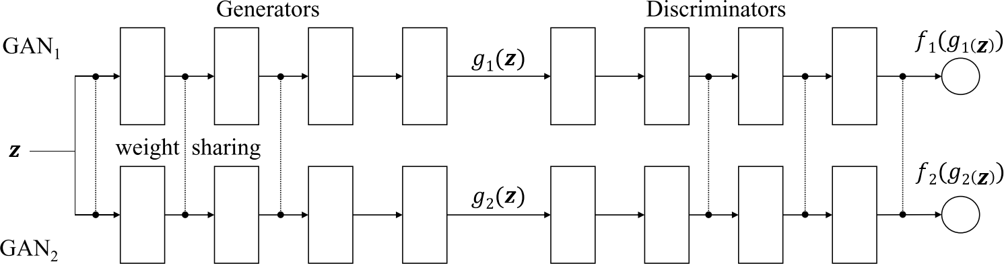
Coupled GANs
Architecture
Figure 1 of the original paper.
Weight-sharing constraints the network to learn a joint distribution without corresponding supervision.
Liu, Ming-Yu, and Oncel Tuzel. “Coupled generative adversarial networks”. NIPS (2016).

Slide 35
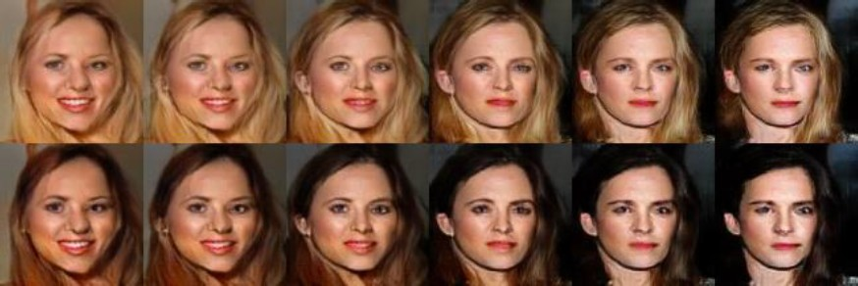
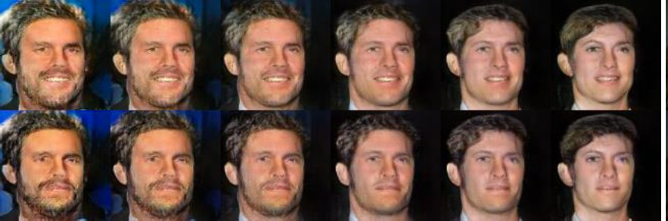
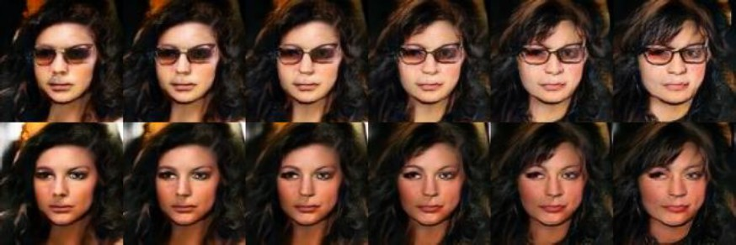
Coupled GANs
Hair Color
Some examples of generating facial images across different feature domains.
Facial Expression
Corresponding images in a column are generate from the same latent code 𝑧
Sunglasses
Figure 4 in the original paper.
Liu, Ming-Yu, and Oncel Tuzel. “Coupled generative adversarial networks”. NIPS (2016).

Slide 36
Summary
GANs are generative models that are implemented using two stochastic neural network modules: Generator and Discriminator.
Generator tries to generate samples from random noise as input
Discriminator tries to distinguish the samples from Generator and samples from the real data distribution.
Both networks are trained adversarially (in tandem) to fool the other component. In this process, both models become better at their respective tasks.

Slide 37
Why use GANs for Generation?
Can be trained using back-propagation for Neural Network based Generator/Discriminator functions.
Sharper images can be generated.
Faster to sample from the model distribution: single forward pass generates a single sample.

Slide 38
Reading List
Goodfellow, I., Pouget-Abadie, J., Mirza, M., Xu, B., Warde-Farley, D., Ozair, S., Courville, A. and Bengio, Y. Generative adversarial nets, NIPS (2014).
Goodfellow, Ian NIPS 2016 Tutorial: Generative Adversarial Networks, NIPS (2016).
Radford, A., Metz, L. and Chintala, S., Unsupervised representation learning with deep convolutional generative adversarial networks. arXiv preprint arXiv:1511.06434. (2015).
Salimans, T., Goodfellow, I., Zaremba, W., Cheung, V., Radford, A., & Chen, X. Improved techniques for training gans. NIPS (2016).
Chen, X., Duan, Y., Houthooft, R., Schulman, J., Sutskever, I., & Abbeel, P. InfoGAN: Interpretable Representation Learning by Information Maximization Generative Adversarial Nets, NIPS (2016).
Zhao, Junbo, Michael Mathieu, and Yann LeCun. Energy-based generative adversarial network. arXiv preprint arXiv:1609.03126 (2016).
Mirza, Mehdi, and Simon Osindero. Conditional generative adversarial nets. arXiv preprint arXiv:1411.1784 (2014).
Liu, Ming-Yu, and Oncel Tuzel. Coupled generative adversarial networks. NIPS (2016).
Denton, E.L., Chintala, S. and Fergus, R., 2015. Deep Generative Image Models using a Laplacian Pyramid of Adversarial Networks. NIPS (2015)
Dumoulin, V., Belghazi, I., Poole, B., Lamb, A., Arjovsky, M., Mastropietro, O., & Courville, A. Adversarially learned inference. arXiv preprint arXiv:1606.00704 (2016).
Applications:
Isola, P., Zhu, J. Y., Zhou, T., & Efros, A. A. Image-to-image translation with conditional adversarial networks. arXiv preprint arXiv:1611.07004. (2016).
Reed, S., Akata, Z., Yan, X., Logeswaran, L., Schiele, B., & Lee, H. Generative adversarial text to image synthesis. JMLR (2016).
Antipov, G., Baccouche, M., & Dugelay, J. L. (2017). Face Aging With Conditional Generative Adversarial Networks. arXiv preprint arXiv:1702.01983.
DALL·E 2 can make realistic edits to existing images from a natural language caption. It can add and remove elements while taking shadows, reflections, and textures into account.

